Slide 1
W4111 – Introduction to Databases Section 002, Spring 2024 Lecture 11 Module II (4), NoSQL (4)
© Donald F. Ferguson, 2024

Slide 2
W4111 – Introduction to Databases Section 002, Spring 2024 Lecture 11 Module II (4), NoSQL (4)
We will start in a couple of minutes.
© Donald F. Ferguson, 2024

Slide 3

Module II, Part 4
3 | COMS W4111_002_2024_1 - Lecture 11: Module II (4), Normalization, NoSQL (4) © Donald F. Ferguson, 2024

Slide 4

Reminder
4 | COMS W4111_002_2024_1 - Lecture 11: Module II (4), Normalization, NoSQL (4) © Donald F. Ferguson, 2024

Slide 5

Transactions
Find things quickly.
Load/Save quickly.
Transactions
Durability
Database Systems: The Complete Book (2nd Edition) by Hector Garcia-Molina (Author), Jeffrey D. Ullman (Author), Jennifer Widom (Author)

Slide 6
ACID Concepts
6 | COMS W4111_002_2024_1 - Lecture 11: Module II (4), Normalization, NoSQL (4) © Donald F. Ferguson, 2024

Slide 7
Core Transaction Concept is ACID Properties
http://slideplayer.com/slide/9307681
ACID
Atomic
“ALL OR NOTHING”
Transaction cannot be subdivided
Consistent
Transaction → transforms database from one consistent state to another consistent state
Isolated
Transactions execute independently of one another
Database changes not revealed to users until after transaction has completed
Durable
Database changes are permanent
The permanence of the database’s consistent state

Slide 8
ACID Properties (httpwww.tutorialspoint.com/dbms/dbms_transaction.htm)
A transaction is a very small unit of a program and it may contain several low-level tasks. A transaction in a database system must maintain Atomicity, Consistency, Isolation, and Durability − commonly known as ACID properties − in order to ensure accuracy, completeness, and data integrity.
Atomicity − This property states that a transaction must be treated as an atomic unit, that is, either all of its operations are executed or none. There must be no state in a database where a transaction is left partially completed. States should be defined either before the execution of the transaction or after the execution/abortion/failure of the transaction.
Consistency − The database must remain in a consistent state after any transaction. No transaction should have any adverse effect on the data residing in the database. If the database was in a consistent state before the execution of a transaction, it must remain consistent after the execution of the transaction as well.
Durability − The database should be durable enough to hold all its latest updates even if the system fails or restarts. If a transaction updates a chunk of data in a database and commits, then the database will hold the modified data. If a transaction commits but the system fails before the data could be written on to the disk, then that data will be updated once the system springs back into action.
Isolation − In a database system where more than one transaction are being executed simultaneously and in parallel, the property of isolation states that all the transactions will be carried out and executed as if it is the only transaction in the system. No transaction will affect the existence of any other transaction.

Slide 9
Transaction Concept
A transaction is a unit of program execution that accesses and possibly updates various data items.
E.g., transaction to transfer $50 from account A to account B:
BEGIN TRANSACTION {
1. read(A)
2. A := A – 50
write(A)
4. read(B)
5. B := B + 50
write(B)
COMMIT or ROLLBACK }
Two main issues to deal with:
Failures of various kinds, such as hardware failures and system crashes
Concurrent execution of multiple transactions
BEGIN TRANSACTION {
1. read(A)
2. A := A – 50
write(A)
4. read(B)
5. B := B + 50
write(B)
COMMIT or ROLLBACK }

Slide 10
Example of Fund Transfer
T
Transaction to transfer $50 from account A to account B:
1. read(A)
2. A := A – 50
3. write(A)
4. read(B)
5. B := B + 50
6. write(B)
Atomicity requirement
If the transaction fails after step 3 and before step 6, money will be “lost” leading to an inconsistent database state
Failure could be due to software or hardware
The system should ensure that updates of a partially executed transaction are not reflected in the database
Durability requirement — once the user has been notified that the transaction has completed (i.e., the transfer of the $50 has taken place), the updates to the database by the transaction must persist even if there are software or hardware failures.
B
C

Slide 11
Example of Fund Transfer (Cont.)
Consistency requirement in above example:
The sum of A and B is unchanged by the execution of the transaction
In general, consistency requirements include
Explicitly specified integrity constraints such as primary keys and foreign keys
Implicit integrity constraints
e.g., sum of balances of all accounts, minus sum of loan amounts must equal value of cash-in-hand
A transaction must see a consistent database.
During transaction execution the database may be temporarily inconsistent.
When the transaction completes successfully the database must be consistent
Erroneous transaction logic can lead to inconsistency

Slide 12
Example of Fund Transfer (Cont.)
Isolation requirement — if between steps 3 and 6, another transaction T2 is allowed to access the partially updated database, it will see an inconsistent database (the sum A + B will be less than it should be).
T1 T2
1. read(A)
2. A := A – 50
write(A) read(A)
read(B) print(A+B)
4. read(B)
5. B := B + 50
6. write(B)
Isolation can be ensured trivially by running transactions serially
That is, one after the other.
However, executing multiple transactions concurrently has significant benefits, as we will see later.
T1, T2
T1
T2

Slide 13
Transaction State
Active – the initial state; the transaction stays in this state while it is executing
Partially committed – after the final statement has been executed.
Failed -- after the discovery that normal execution can no longer proceed.
Aborted – after the transaction has been rolled back and the database restored to its state prior to the start of the transaction. Two options after it has been aborted:
Restart the transaction
Can be done only if no internal logical error
Kill the transaction
Committed – after successful completion.

Slide 14
Atomicity Durability
14 | COMS W4111_002_2024_1 - Lecture 11: Module II (4), Normalization, NoSQL (4) © Donald F. Ferguson, 2024

Slide 15
Atomicity
A transaction is a logical unit of work that must be either entirely completed or entirely undone. (All writes happen or none of them happen)
OK. What does this mean? Consider some pseudo-code
def transfer(source_acct_id, target_acct_id, amount)
Check that both accounts exist.
IF is_checking_account(source_acct_id)
Check that (source_acct.balance-amount) > source_account.overdraft_limit
ELSE
Check that (source_count.balance-amount) >source_account.minimum_balance
Update source account
Update target account.
INSERT a record into transfer tracking table.

Slide 16
Atomicity
A transaction is a logical unit of work that must be either entirely completed or entirely undone. (All writes happen or none of them happen)
OK. What does this mean? Consider some pseudo-code
def transfer(source_acct_id, target_acct_id, amount)
Check that both accounts exist.
IF is_checking_account(source_acct_id)
Check that (source_acct.balance-amount) > source_account.overdraft_limit
ELSE
Check that (source_count.balance-amount) >source_account.minimum_balance
Update source account
Update target account.
INSERT a record into transfer tracking table.
Computer or DB Server fails.

Slide 17
Atomicity
Transaction programs and databases are fast (milliseconds). What are the chances of the failure occurring in the wrong spot?
Well, that doesn’t really matter. If it happens,
Someone lost money and
There is no record off it. Someone is going to very upset.
Even a small server can have thousands of concurrent transactions ➔
There will be corruptions because some transaction will be in the wrong place at the wrong time.
Unless we do something in the DBMS
Because HW and software inevitably fail
And sadly, SW is especially prone to failure when under load

Slide 18
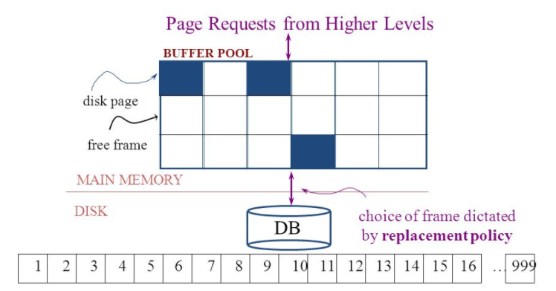
Simplistic Approach
Begin
Update A
Update B
Update C
Commit (REQ)
Force to disk
Commit (RSP)

Slide 19
Simplistic Approach
There are several problems with the simplistic approach.
The approach does not solve the problem
Some writes might succeed.
Some might be interrupted by the failure, or require retry.
Writes may be random and scattered. N updates might
Change a few bytes in N data frames
A few bytes in M index frames
Transaction rate becomes bottlenecked by write I/O rate, even though a relative small number of bytes change/transaction.
Written frames must be held in memory.
Lots of transactions
Randomly writing small pieces of lots of frames.
Consumes lots of memory with pinned pages.
Degrades the performance and optimization of the buffer.
The optimal buffer replacement policy wants to hold frames that will be reused.
Not frames that have been touched and never reused.

Slide 20
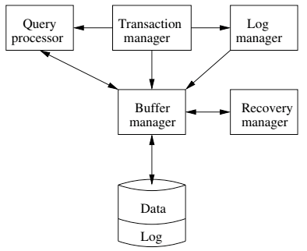
DBMS ACID Implementation
Implementation Subsystems
Query processor schedules and executes queries.
Buffer manager controls reading/writing blocks/frames to/from disk.
Log manager journals/records events to disk (log), e.g.
Transaction start/commit/abort
Transaction update of a block and previous value of data.
Transaction manager coordinates query scheduling, buffer read/write and logging to ensure ACID.
Recovery manager processes log to ensure ACID even after transaction or system failures.
Log is a special type of block file used by the system to optimize performance and ensure ACID.
Garcia-Molina et al., p. 846

Slide 21
Logging
The DBMS logs every transaction event
Log Sequence Number (LSN): A unique ID for a log record.
Prev LSN: A link to their last log record.
Transaction ID number.
Type: Describes the type of database log record.
Update Log Record
PageID: A reference to the Page ID of the modified page.
Length and Offset: Length in bytes and offset of the page are usually included.
Before and After Images of records.
Compensation Log Record
Commit Record
Abort Record Checkpoint Record
Completion Record notes that all work has been done for this particular transaction.

Slide 22
Write Ahead Logging
Begin
Update A
Update B
Update C
Commit (REQ)
Force to disk
Commit (RSP)
DBMS (Redo processing)
Write log events from all transactions into a single log stream.
Multiple events per page
Forces (writes) log record on COMMIT/ABORT
Single block I/O records many updates
Versus multiple block I/Os, each recording a single change.
All of a transaction’s updates recorded in one I/O versus many.
If there is a failure
DBMS sequentially reads log.
Applies changes to modified pages that were not saved to disk.
Then resumes normal processing.
Log

Slide 23
Write Ahead Logging
Force every write to disk?
Poor response time.
But provides durability.
Steal buffer-pool frames from uncommitted transactions?
If not, poor performance/caching performance
If yes, how can we ensure atomicity? Uncommitted updates on disk
DBMS (Undo processing)
Enable steal policy to improve cache performance by
Avoiding lots of pinned pages
Unlikely to be reused soon.
Before stealing
Force log record to disk.
Update log entry has data record
Before image
After image
If there is a failure
DBMS sequentially reads log.
Undoes changes to
modified pages, uncommitted pages
That were saved to disk.
Then resumes normal processing.
No Steal
Steal
Force
Trivial
No Force
Desired

Slide 24
ARIES Algorithm = Algorithms for Recovery and Isolation Exploiting Semantics
ARIES recovery involves three passes
Analysis pass:
Determine which transactions to undo
Determine which pages were dirty (disk version not up to date) at time of
RedoLSN: LSN from which redo should start
Redo pass:
Repeats history, redoing all actions from RedoLSN (updated committed but not written changes to pages)
RecLSN and PageLSNs are used to avoid redoing actions already reflected on page
Undo pass:
Rolls back all incomplete transactions (with uncommitted pages written to disk).
Transactions whose abort was complete earlier are not undone

Slide 25
Durability
Write changes to disk trivially achieves durability.
DBMS engine uses write-ahead-logging to
Achieve durability
But with better performance through more efficient caching and I/O.
Well, disks fail. How is that durable.
RAID and other solutions.
Disk subsystems, including entire RAID device, fail →
Duplex writes
To independent disk subsystems.
Well, there are earthquakes, floods, etc.

Slide 26
Availability and Replication
There are two basic patterns
Active/Passive
All requests go to master during normal processing.
Updates are transactionally queued for processing at passive backup.
Failure of master
Routes subsequent requests to backup.
Backup must process and commit updates before accepting requests.
Active/Active
Both environments process requests.
Some form of distributed transaction commit required to synchronize updates on both copies.
Multi-system communication to guarantee consistency is the foundation for tradeoffs in CAP.
The system can be CAP if and only iff
There are never any partitions or system failures
Which is unrealistic in cloud/Internet systems.

Slide 27
Isolation
27 | COMS W4111_002_2024_1 - Lecture 11: Module II (4), Normalization, NoSQL (4) © Donald F. Ferguson, 2024

Slide 28
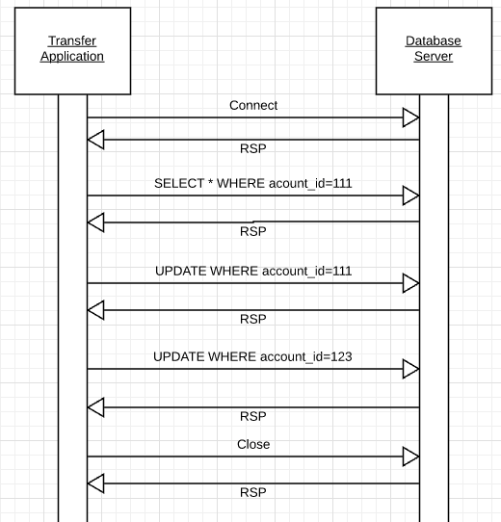
Isolation
Transfer $50 from
account_id=111 to
account_id=123
Requires 3 SQL statements
SELECT from 111 to check balance >= $50
UPDATE account_id=111
UPDATE account_id=123
There are some interesting scenarios
Two different programs read the balance ($51)
And decide removing $50 is OK.
DB constraints can prevent the conflict from happening, but …
There are more complex scenarios that constraints do not prevent.
Not ALL databases support constraints.
The “correct” execution should be that
One transaction responds “insufficient funds”
Before attempting transfer instead of after attempting.
Multiple readers

Slide 29
Isolation
Consider two simultaneous transfer transactions T1 and T2.
There are two equally correct executions
T1 transfers, T2 responds “insufficient funds” and does not attempt transfer
T2 transfers, T1 responds “insufficient funds” and does not attempt transfer
Each correct simultaneous execution is equivalent to a serial (sequential) execution schedule
(1) Execute T1, Execute T2
(2) Execute T2, Execute T1
NOTE:
We are focusing on correctness not
Fairness:
We do not care which transaction was actually submitted first.
And probably do not know due to networking, etc.
Transfer $50 from
account_id=111 to
account_id=123
Requires 3 SQL statements
SELECT from 111 to check balance >= $50
UPDATE account_id=111
UPDATE account_id=123
There are some interesting scenarios
Two different programs read the balance ($51)
And decide removing $50 is OK.
DB constraints can prevent the conflict from happening, but …
There are more complex scenarios that constraints do not prevent.
Not ALL databases support constraints.
The “correct” execution should be that
One transaction responds “insufficient funds”
Before attempting transfer instead of after attempting.
Multiple readers

Slide 30
Serializability
“In concurrency control of databases,^{[1][2]} transaction processing (transaction management), and various transactional applications (e.g., transactional memory^{[3]} and software transactional memory), both centralized and distributed, a transaction schedule is serializable if its outcome (e.g., the resulting database state) is equal to the outcome of its transactions executed serially, i.e. without overlapping in time. Transactions are normally executed concurrently (they overlap), since this is the most efficient way. Serializability is the major correctness criterion for concurrent transactions' executions. It is considered the highest level of isolation between transactions, and plays an essential role in concurrency control. As such it is supported in all general purpose database systems.” (https://en.wikipedia.org/wiki/Serializability)

Slide 31
DBMS ACID Implementation
Implementation Subsystems
Query processor schedules and executes queries.
Buffer manager controls reading/writing blocks/frames to/from disk.
Log manager journals/records events to disk (log), e.g.
Transaction start/commit/abort
Transaction update of a block and previous value of data.
Transaction manager coordinates query scheduling, buffer read/write and logging to ensure ACID.
Recovery manager processes log to ensure ACID even after transaction or system failures.
Log is a special type of block file used by the system to optimize performance and ensure ACID.
Garcia-Molina et al., p. 846

Slide 32
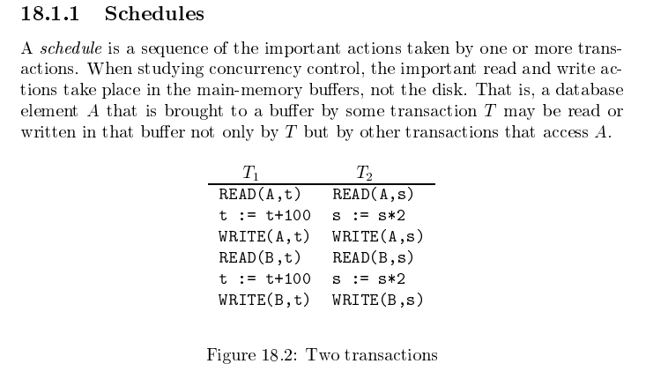
Schedule
T1, T2
T2, T1
Garcia-Molina et al.

Slide 33
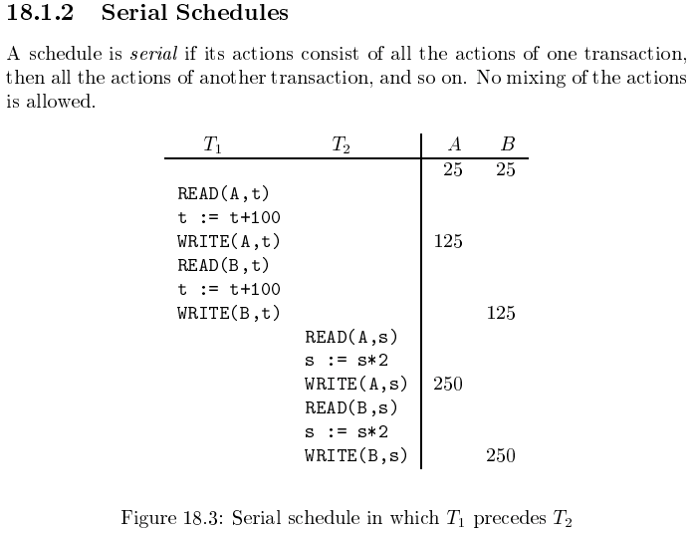
Serializable
Assume there are three
concurrently executing transactions
T1, T2 and T3
The transaction manager
Enables concurrent execution
But schedules individual operations
To ensure that the final DB state
Is equivalent to one of the following schedules
T1, T2, T3
T1, T3, T2
T2, T1, T3
T2, T3, T1
T3, T1, T2
T3, T2, T1
Concurrent execution was serializable.

Slide 34
Serializability (en.wikipedia.org/wiki/Serializability)
Serializability is used to keep the data in the data item in a consistent state. Serializability is a property of a transaction schedule (history). It relates to the isolation property of a database transaction.
Serializability of a schedule means equivalence (in the outcome, the database state, data values) to a serial schedule (i.e., sequential with no transaction overlap in time) with the same transactions. It is the major criterion for the correctness of concurrent transactions' schedule, and thus supported in all general purpose database systems.
The rationale behind serializability is the following:
If each transaction is correct by itself, i.e., meets certain integrity conditions,
then a schedule that comprises any serial execution of these transactions is correct (its transactions still meet their conditions):
"Serial" means that transactions do not overlap in time and cannot interfere with each other, i.e, complete isolation between each other exists.
Any order of the transactions is legitimate, (…)
As a result, a schedule that comprises any execution (not necessarily serial) that is equivalent (in its outcome) to any serial execution of these transactions, is correct.

Slide 35
Lock-Based Concurrency Control
Strict Two-phase Locking (Strict 2PL) Protocol:
Each Xact must obtain a S (shared) lock on object before reading, and an X (exclusive) lock on object before writing.
All locks held by a transaction are released when the transaction completes
(Non-strict) 2PL Variant: Release locks anytime, but cannot acquire locks after releasing any lock.
If an Xact holds an X lock on an object, no other Xact can get a lock (S or X) on that object.
Strict 2PL allows only serializable schedules.
Additionally, it simplifies transaction aborts
(Non-strict) 2PL also allows only serializable schedules, but involves more complex abort processing

Slide 36
Aborting a Transaction
If a transaction Ti is aborted, all its actions have to be undone. Not only that, if Tj reads an object last written by Ti, Tj must be aborted as well!
Most systems avoid such cascading aborts by releasing a transaction’s locks only at commit time.
If Ti writes an object, Tj can read this only after Ti commits.
In order to undo the actions of an aborted transaction, the DBMS maintains a log in which every write is recorded. This mechanism is also used to recover from system crashes: all active Xacts at the time of the crash are aborted when the system comes back up.

Slide 37
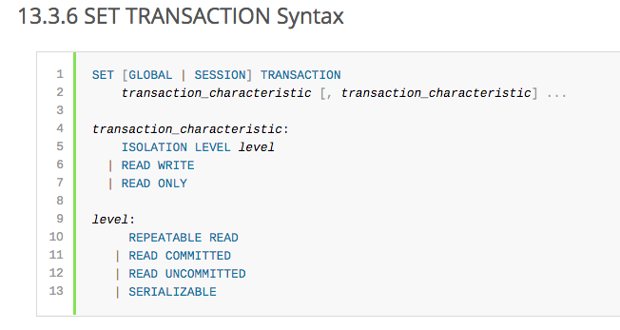
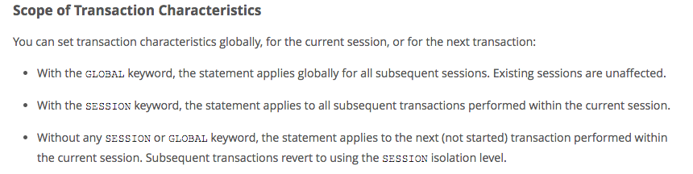
MySQL (Locking) Isolation

Slide 38
Isolation Levels (https://en.wikipedia.org/wiki/Isolation_(database_systems)
Not all transaction use cases require 2PL and serializable execution. Databases support a a set of levels.
Serializable
With a lock-based concurrency control DBMS implementation, serializability requires read and write locks (acquired on selected data) to be released at the end of the transaction. Also range-locks must be acquired when a SELECT query uses a ranged WHERE clause, especially to avoid the phantom reads phenomenon.
The execution of concurrent SQL-transactions at isolation level SERIALIZABLE is guaranteed to be serializable. A serializable execution is defined to be an execution of the operations of concurrently executing SQL-transactions that produces the same effect as some serial execution of those same SQL-transactions. A serial execution is one in which each SQL-transaction executes to completion before the next SQL-transaction begins.
Repeatable reads
In this isolation level, a lock-based concurrency control DBMS implementation keeps read and write locks (acquired on selected data) until the end of the transaction. However, range-locks are not managed, so phantom reads can occur.
Write skew is possible at this isolation level, a phenomenon where two writes are allowed to the same column(s) in a table by two different writers (who have previously read the columns they are updating), resulting in the column having data that is a mix of the two transactions.^{[3][4]}
Read committed
In this isolation level, a lock-based concurrency control DBMS implementation keeps write locks (acquired on selected data) until the end of the transaction, but read locks are released as soon as the SELECT operation is performed (so the non-repeatable reads phenomenon can occur in this isolation level). As in the previous level, range-locks are not managed.
Putting it in simpler words, read committed is an isolation level that guarantees that any data read is committed at the moment it is read. It simply restricts the reader from seeing any intermediate, uncommitted, 'dirty' read. It makes no promise whatsoever that if the transaction re-issues the read, it will find the same data; data is free to change after it is read.
Read uncommitted
This is the lowest isolation level. In this level, dirty reads are allowed, so one transaction may see not-yet-committed changes made by other transactions

Slide 39
R JOIN S
For r in R:
For s in S: (s1, s4, s2, s3,)
Check condition and see if I need to join (r, s).

Slide 40
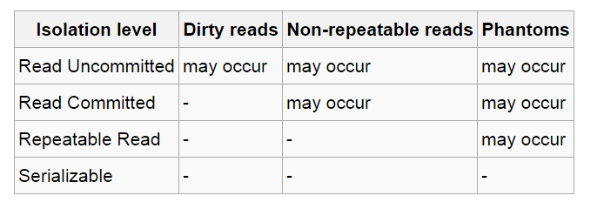
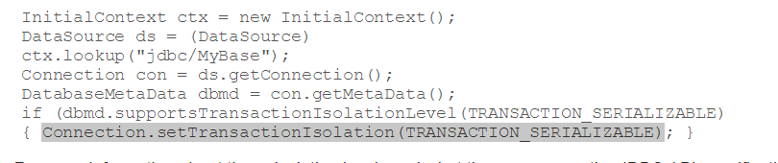
In Databases, Cursors Define Isolation
We have talked about ACID transactions
Atomic: A set of writes all occur or none occur.
Durable: The data “does not disappear,” e.g. write to disk.
Consistent: My applications move the database between consistent states, e.g. the transfer function works correctly.
Isolation
Determines what happens when two or more threads are manipulating the data at the same time.
And is defined relative to where cursors are and what they have touched.
Because the cursor movement determines what you are reading or have read.
But, … Cursors are client conversation state and cannot be used in REST.

Slide 41
Relational Database Design Normalization
41 | COMS W4111_002_2024_1 - Lecture 11: Module II (4), Normalization, NoSQL (4) © Donald F. Ferguson, 2024

Slide 42
Overview of Normalization

Slide 43
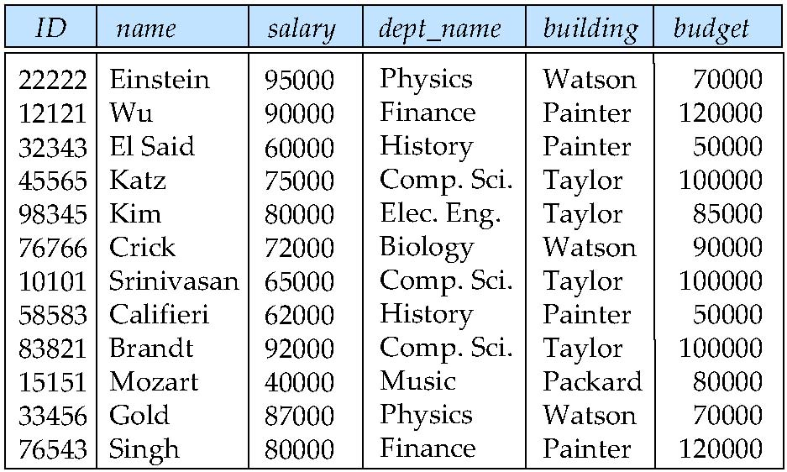
Features of Good Relational Designs
Hypothetically, assume our schema originally had one relation that provided information about faculty and departments.
Suppose we combine instructor and department into in_dep, which represents the natural join on the relations instructor and department
There is repetition of information
Need to use null values (if we add a new department with no instructors)
Instructor(id, name, salary, dept_name)
Department(dept_name, building, budget)

Slide 44
Decomposition
The only way to avoid the repetition-of-information problem in the in_dep schema is to decompose it into two schemas – instructor and department schemas.
Not all decompositions are good. Suppose we decompose
employee(ID, name, street, city, salary)
into
employee1 (ID, name)
employee2 (name, street, city, salary)
The problem arises when we have two employees with the same name
The next slide shows how we lose information -- we cannot reconstruct the original employee relation -- and so, this is a lossy decomposition.

Slide 45
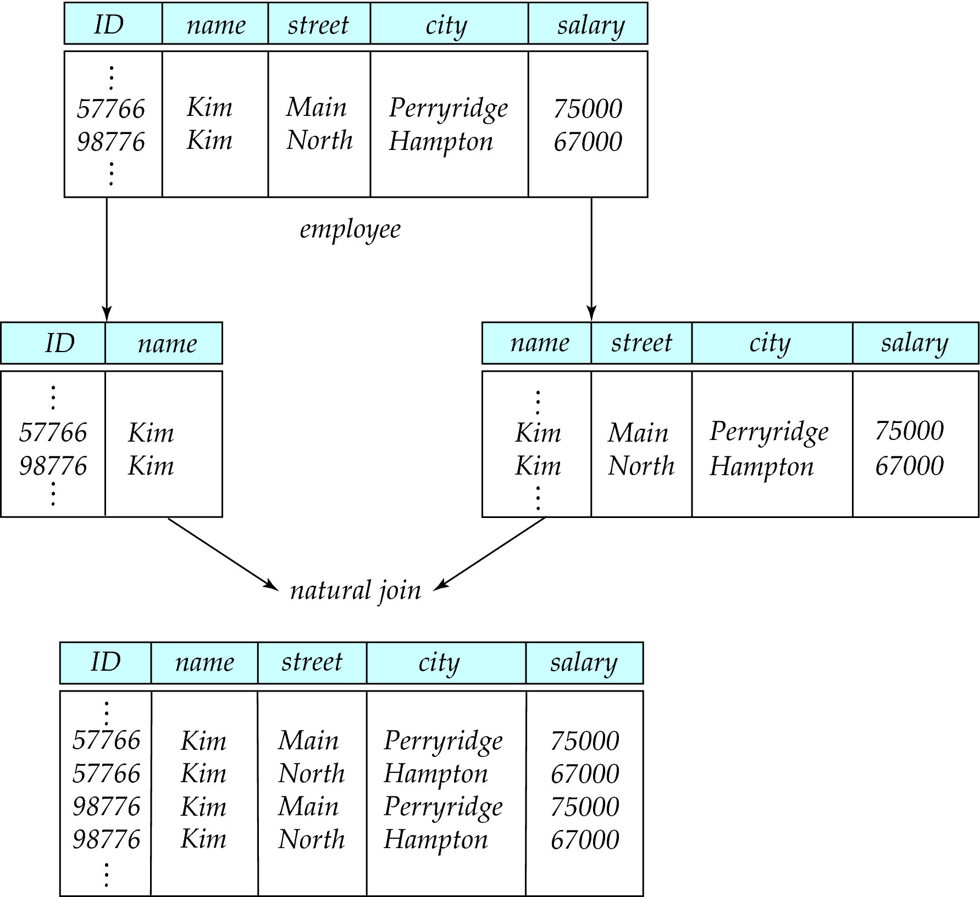
Lossy Decomposition

Slide 46
The Evils of Redundancy
Redundancy is at the root of several problems associated with relational schemas:
redundant storage, insert/delete/update anomalies
Integrity constraints, in particular functional dependencies, can be used to identify schemas with such problems and to suggest refinements.
Main refinement technique: decomposition (replacing ABCD with, say, AB and BCD, or ACD and ABD).
Decomposition should be used judiciously:
Is there reason to decompose a relation?
What problems (if any) does the decomposition cause?
Notes:
14

Slide 47
Example (Contd.)
Wages
Hourly_Emps2
Problems due to R W :
Update anomaly: Can we change W in just the 1st tuple of SNLRWH?
Insertion anomaly: What if we want to insert an employee and don’t know the hourly wage for his rating?
Deletion anomaly: If we delete all employees with rating 5, we lose the information about the wage for rating 5!
Will 2 smaller tables be better?
Notes:
17

Slide 48
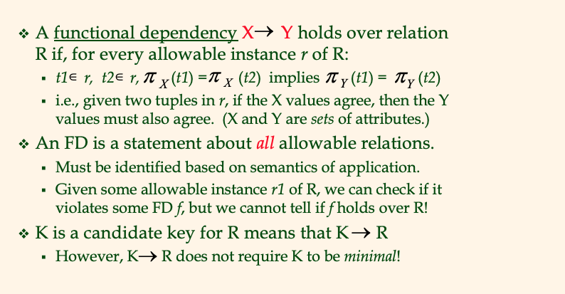
Functional Dependencies (FDs)
Notes:
15

Slide 49
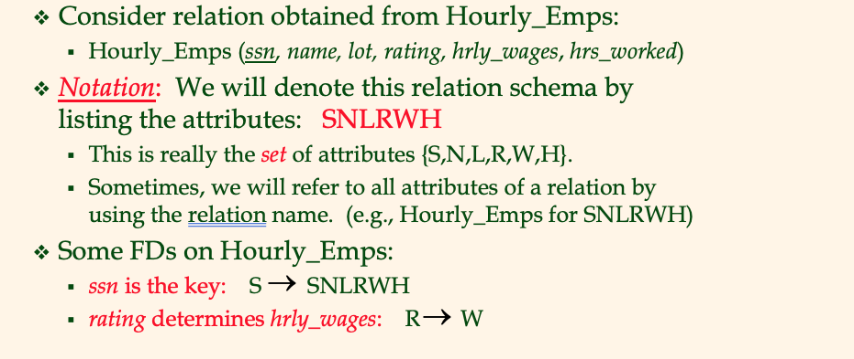
Example: Constraints on Entity Set
Notes:
16

Slide 50
F⁺
(uni, email, last_name, first_name) uni and email are candidate (not NULL, unique)
Uni → email
Email → (last_name, first_name)
➔ Uni → (last_name, first_name)
Person:(uni, email, last_name, first_name), ContactInfo: (email, phone_number, dorm_name)
Uni → email
Email → phone_number, dorm_name
Uni → phone_number, dorm_name

Slide 51
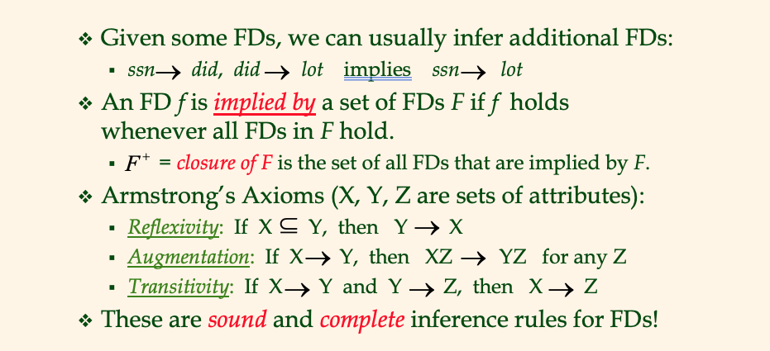
Reasoning About FDs
Notes:
19

Slide 52
Lossless Decomposition
Let R be a relation schema and let R₁ and R₂ form a decomposition of R.
That is R = R₁ U R₂
Note: This notation is confusing. This is a statement about the schema, not about the data in relations.
We say that the decomposition is a lossless decomposition if there is no loss of information by replacing R with the two relation schemas R₁ U R₂
Formally,
∏ _{R1} (r) ∏ _{R2} (r) = r
And, conversely a decomposition is lossy if
r ⊂ ∏ _{R1} (r) ∏ _{R2} (r) = r

Slide 53
Normalization Theory
Decide whether a particular relation R is in “good” form.
In the case that a relation R is not in “good” form, decompose it into set of relations {R₁, R₂, ..., R_{n}} such that
Each relation is in good form
The decomposition is a lossless decomposition
Our theory is based on:
Functional dependencies
Multivalued dependencies

Slide 54
Functional Dependencies
There are usually a variety of constraints (rules) on the data in the real world.
For example, some of the constraints that are expected to hold in a university database are:
Students and instructors are uniquely identified by their ID.
Each student and instructor has only one name.
Each instructor and student is (primarily) associated with only one department.
Each department has only one value for its budget, and only one associated building.

Slide 55
Functional Dependencies (Cont.)
An instance of a relation that satisfies all such real-world constraints is called a legal instance of the relation;
A legal instance of a database is one where all the relation instances are legal instances
Constraints on the set of legal relations.
Require that the value for a certain set of attributes determines uniquely the value for another set of attributes.
A functional dependency is a generalization of the notion of a key.

Slide 56
Functional Dependencies Definition
Let R be a relation schema
α ⊆ R and β ⊆ R
The functional dependency
α → β
holds on R if and only if for any legal relations r(R), whenever any two tuples t₁ and t₂ of r agree on the attributes α, they also agree on the attributes β. That is,
t₁[α] = t₂ [α] ⇒ t₁[β ] = t₂ [β ]
Example: Consider r(A,B ) with the following instance of r.
On this instance, B → A hold; A → B does NOT hold,
4
1 5
3 7

Slide 57
Closure of a Set of Functional Dependencies
Given a set F set of functional dependencies, there are certain other functional dependencies that are logically implied by F.
If A → B and B → C, then we can infer that A → C
etc.
The set of all functional dependencies logically implied by F is the closure of F.
We denote the closure of F by F⁺.

Slide 58
Keys and Functional Dependencies
K is a superkey for relation schema R if and only if K → R
K is a candidate key for R if and only if
K → R, and
for no α ⊂ K, α → R
Functional dependencies allow us to express constraints that cannot be expressed using superkeys. Consider the schema:
in_dep (ID, name, salary, dept_name, building, budget ).
We expect these functional dependencies to hold:
dept_name→ building
ID → building
but would not expect the following to hold:
dept_name → salary
DFF Note:
In the current data: ID → dept_name → building
But
In the schema, dept_name may be NULL..

Slide 59
Use of Functional Dependencies
We use functional dependencies to:
To test relations to see if they are legal under a given set of functional dependencies.
If a relation r is legal under a set F of functional dependencies, we say that r satisfies F.
To specify constraints on the set of legal relations
We say that F holds on R if all legal relations on R satisfy the set of functional dependencies F.
Note: A specific instance of a relation schema may satisfy a functional dependency even if the functional dependency does not hold on all legal instances.
For example, a specific instance of instructor may, by chance, satisfy name → ID.

Slide 60
Normal Forms

Slide 61
Boyce-Codd Normal Form
A relation schema R is in BCNF with respect to a set F of functional dependencies if for all functional dependencies in F⁺ of the form
α → β
where α ⊆ R and β ⊆ R, at least one of the following holds:
α → β is trivial (i.e., β ⊆ α)
α is a superkey for R
DFF Note:
The theoretical treatment is no conveying the practical intent.
If α is α superkey, I can set a primary key/unique constraint on α.
Consider tables with address info in the rows.

Slide 62
Decomposing a Schema into BCNF
Let R be a schema R that is not in BCNF. Let α →β be the FD that causes a violation of BCNF.
We decompose R into:
(α U β )
( R - ( β - α ) )
In our example of in_dep,
α = dept_name
β = building, budget
and in_dep is replaced by
(α U β ) = ( dept_name, building, budget )
( R - ( β - α ) ) = ( ID, name, dept_name, salary )
Note:
This is an example only.
Zip code does not imply city or state in real world.
DFF Note – again this is baffling
R = (id, name_last, name_first, street, city, state, zipcode)
α → β means zipcode → (city, state)
(α U β ) = (zipcode, city, state), which we call Address
R - ( β - α ) ). = R - β + α = (id, name_last, name_first, zipcode), which we call Person
Setting primary key ID in Address and zipcode on Address preserves the dependency and is lossless.

Slide 63
BCNF and Dependency Preservation
It is not always possible to achieve both BCNF and dependency preservation
Consider a schema:
dept_advisor(s_ID, i_ID, department_name)
With function dependencies:
i_ID → dept_name
s_ID, dept_name → i_ID
dept_advisor is not in BCNF
i_ID is not a superkey.
Any decomposition of dept_advisor will not include all the attributes in
s_ID, dept_name → i_ID
Thus, the composition is NOT be dependency preserving

Slide 64
Third Normal Form
A relation schema R is in third normal form (3NF) if for all:
α → β in F⁺
at least one of the following holds:
α → β is trivial (i.e., β ∈ α)
α is a superkey for R
Each attribute A in β – α is contained in a candidate key for R.
(NOTE: each attribute may be in a different candidate key)
If a relation is in BCNF it is in 3NF (since in BCNF one of the first two conditions above must hold).
Third condition is a minimal relaxation of BCNF to ensure dependency preservation (will see why later).

Slide 65
3NF Example
Consider a schema:
dept_advisor(s_ID, i_ID, dept_name)
With function dependencies:
i_ID → dept_name
s_ID, dept_name → i_ID
Two candidate keys = {s_ID, dept_name}, {s_ID, i_ID }
We have seen before that dept_advisor is not in BCNF
R, however, is in 3NF
s_ID, dept_name is a superkey
i_ID → dept_name and i_ID is NOT a superkey, but:
{ dept_name} – {i_ID } = {dept_name } and
dept_name is contained in a candidate key

Slide 66
Comparison of BCNF and 3NF
Advantages to 3NF over BCNF. It is always possible to obtain a 3NF design without sacrificing losslessness or dependency preservation.
Disadvantages to 3NF.
We may have to use null values to represent some of the possible meaningful relationships among data items.
There is the problem of repetition of information.

Slide 67
Goals of Normalization
Let R be a relation scheme with a set F of functional dependencies.
Decide whether a relation scheme R is in “good” form.
In the case that a relation scheme R is not in “good” form, need to decompose it into a set of relation scheme {R₁, R₂, ..., R_{n}} such that:
Each relation scheme is in good form
The decomposition is a lossless decomposition
Preferably, the decomposition should be dependency preserving.

Slide 68
Denormalization for Performance
May want to use non-normalized schema for performance
For example, displaying prereqs along with course_id, and title requires join of course with prereq
Alternative 1: Use denormalized relation containing attributes of course as well as prereq with all above attributes
faster lookup
extra space and extra execution time for updates
extra coding work for programmer and possibility of error in extra code
Alternative 2: use a materialized view defined a course prereq
Benefits and drawbacks same as above, except no extra coding work for programmer and avoids possible errors

Slide 69
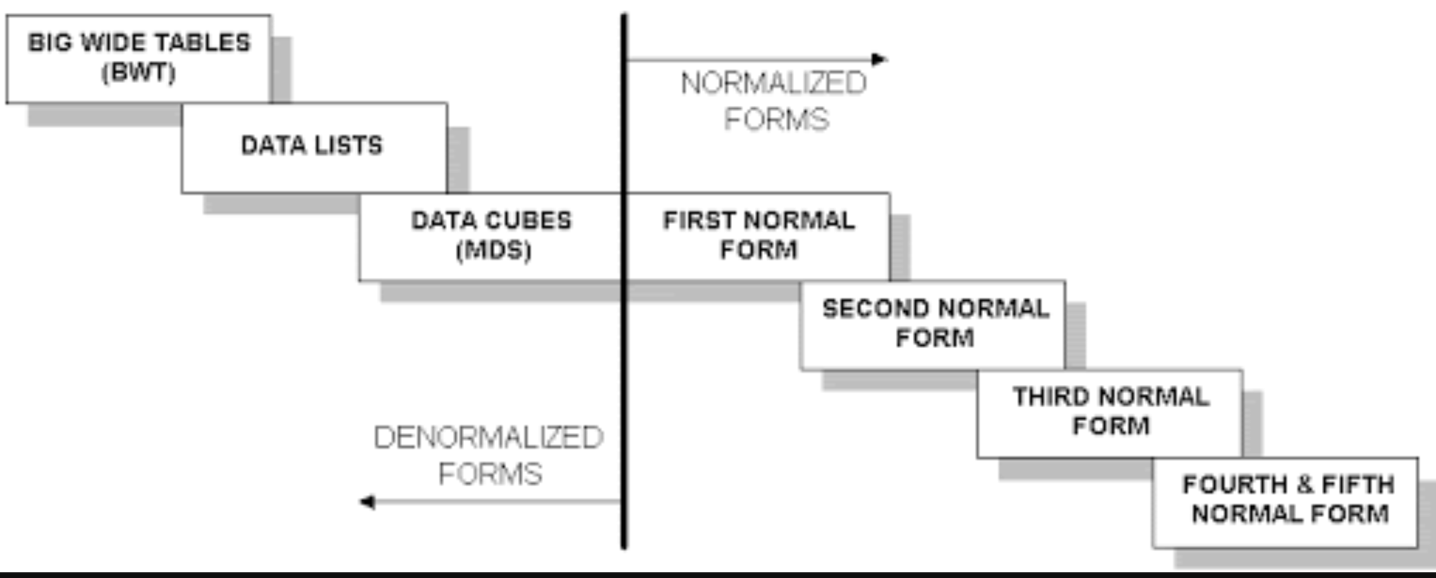
Wide Flat Tables
Good for Integrity
Good for Query
Improve query performance by precomputing and saving:
JOINs
Aggregation
Derived/computed columns
One of the primary strength of the relational model is maintaining “integrity” when applications create, update and delete data. This relies on:
The core capabilities of the relational model, e.g. constraints.
A well-design database (We will cover a formal definition – “normalization” in more detail later.
Data models that are well designed for integrity are very bad for read only analysis queries. We will build and analyze wide flat tables as part of the analysis tasks in HW3, HW4 as projects.

Slide 70
First Normal Form
Domain is atomic if its elements are considered to be indivisible units
Examples of non-atomic domains:
Set of names, composite attributes
Identification numbers like CS 101 that can be broken up into parts
A relational schema R is in first normal form if the domains of all attributes of R are atomic
Non-atomic values complicate storage and encourage redundant (repeated) storage of data
Example: Set of accounts stored with each customer, and set of owners stored with each account
We assume all relations are in first normal form (and revisit this in Chapter 22: Object Based Databases)

Slide 71
First Normal Form (Cont.)
Atomicity is actually a property of how the elements of the domain are used.
Example: Strings would normally be considered indivisible
Suppose that students are given roll numbers which are strings of the form CS0012 or EE1127
If the first two characters are extracted to find the department, the domain of roll numbers is not atomic.
Doing so is a bad idea: leads to encoding of information in application program rather than in the database.

Slide 72
NoSQL (3)
72 | COMS W4111_002_2024_1 - Lecture 11: Module II (4), Normalization, NoSQL (4) © Donald F. Ferguson, 2024

Slide 73
Reminder
73 | COMS W4111_002_2024_1 - Lecture 11: Module II (4), Normalization, NoSQL (4) © Donald F. Ferguson, 2024

Slide 74
Simplistic Classification (https://medium.com/swlh/4-types-of-nosql-databases-d88ad21f7d3b)
Relational is the foundational model.
We will see OLAP in a future lecture.
Continue Today
Begin Today

Slide 75
Graph Databases Neo4j
75 | COMS W4111_002_2024_1 - Lecture 11: Module II (4), Normalization, NoSQL (4) © Donald F. Ferguson, 2024

Slide 76
Graph Database
Exactly what it sounds like
Two core types
Node
Edge (link)
Nodes and Edges have
Label(s) = “Kind”
Properties (free form)
Query is of the form
p1(n)-p2(e)-p3(m)
n, m are nodes; e is an edge
p1, p2, p3 are predicates on labels
N->R->M

Slide 77
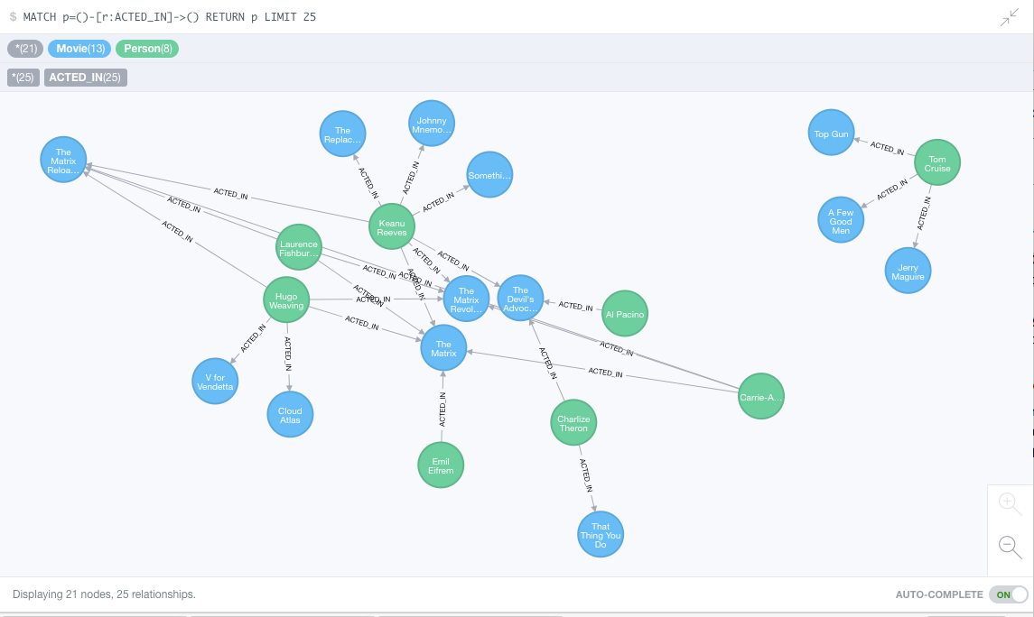
Neo4J Graph Query

Slide 78
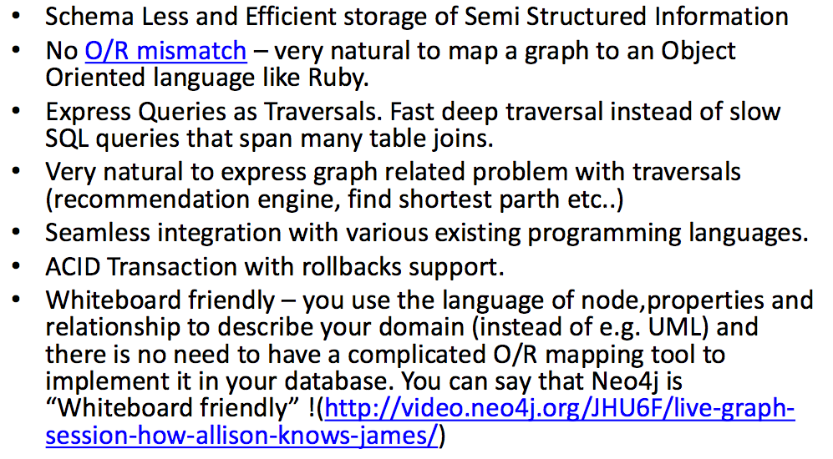
Why Graph Databases?

Slide 79
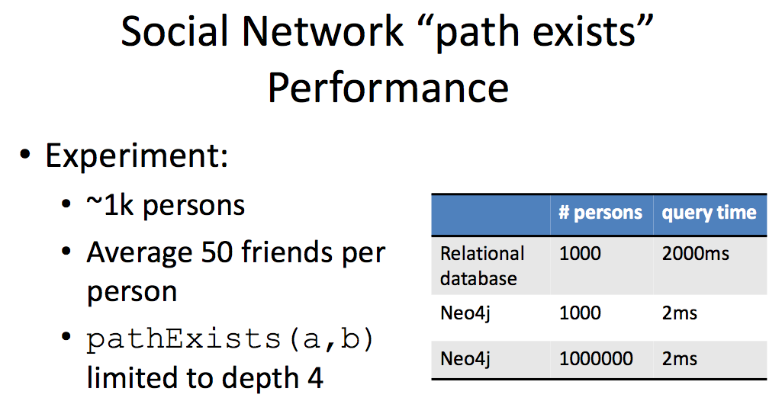
Graph databases are
Extremely fast for some queries and data models.
Implement a language that vastly simplifies writing queries.

Slide 80
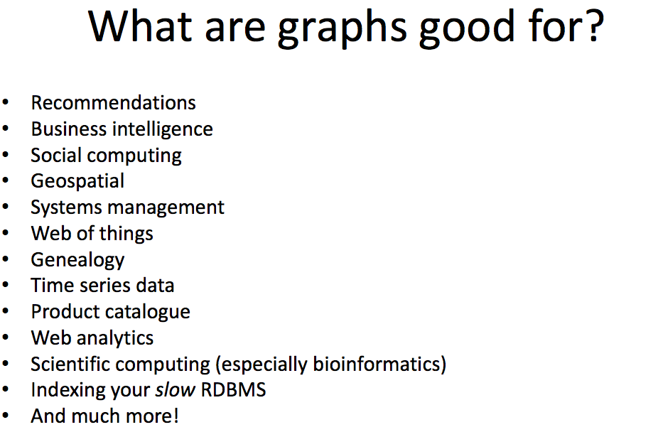

Slide 81
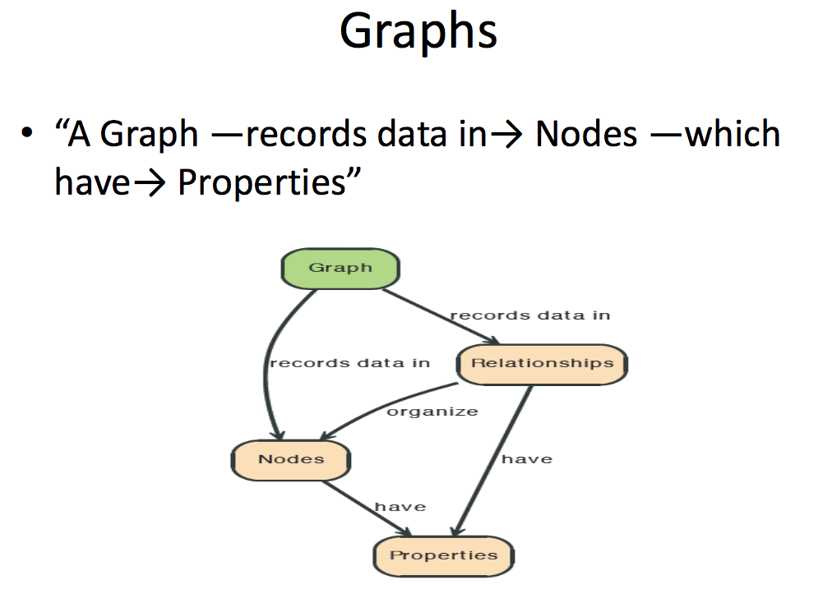

Slide 82
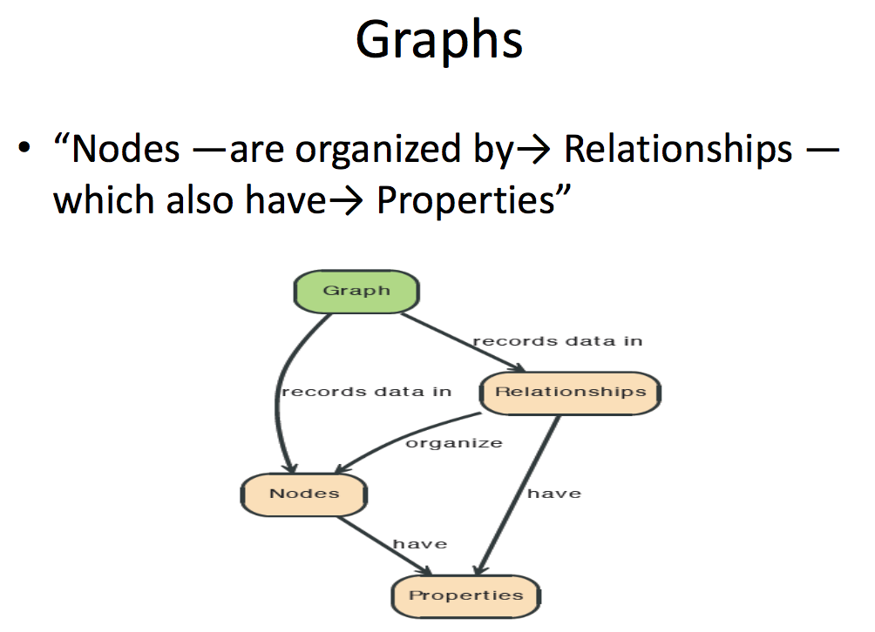

Slide 83
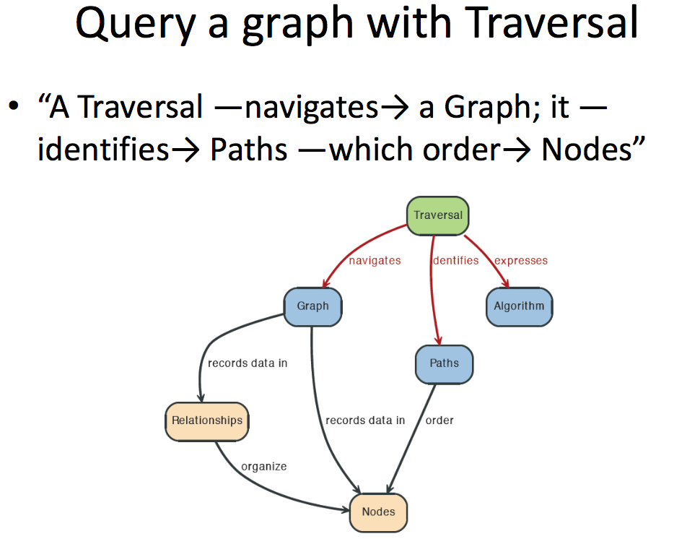

Slide 84
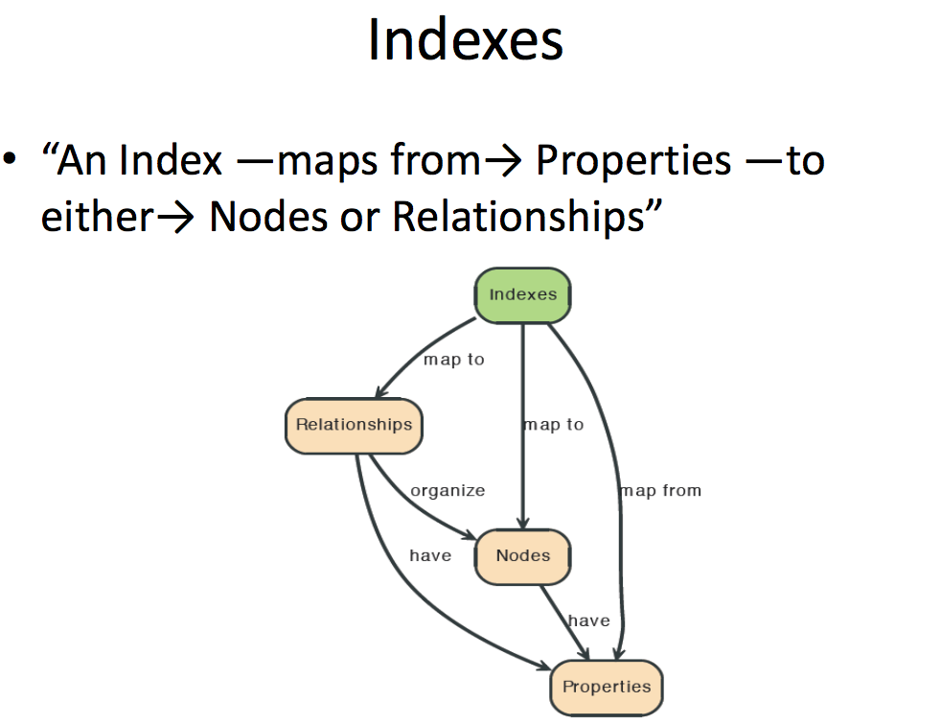

Slide 85
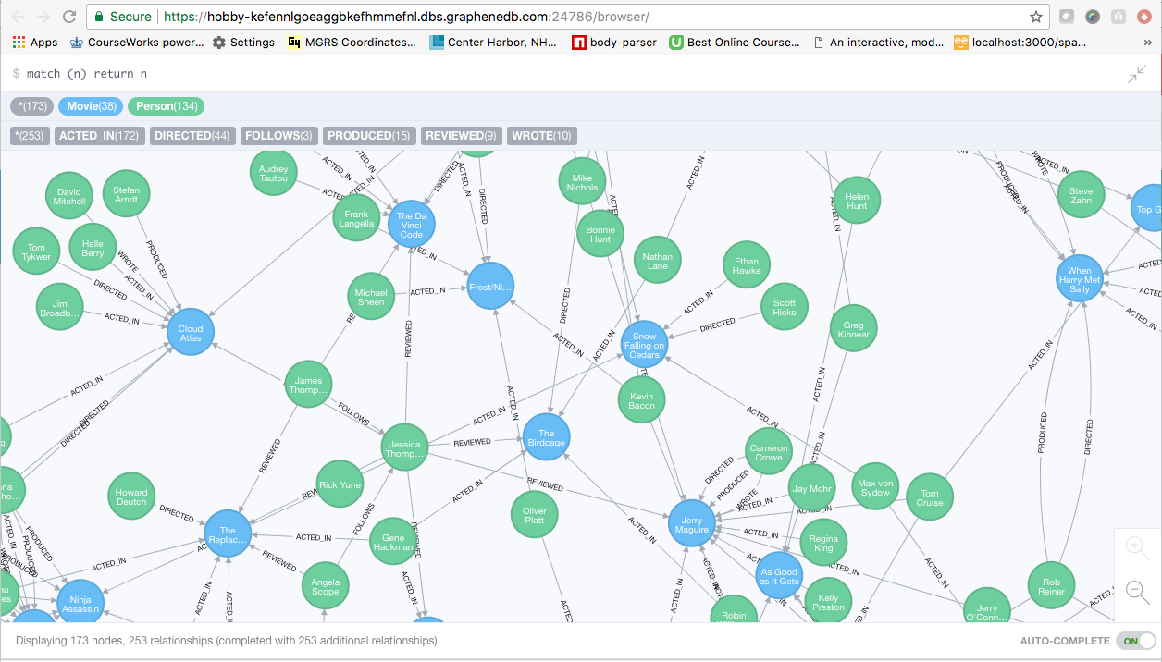
A Graph Database (Sample)

Slide 86
Neo4J Graph Query
Who acted in which movies?

Slide 87
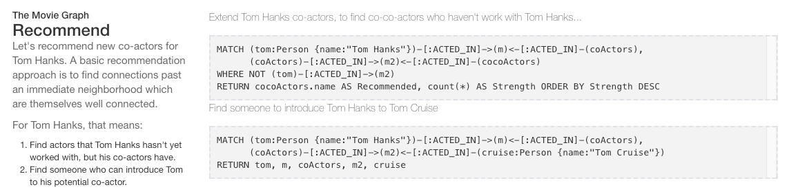
Big Deal. That is just a JOIN.
Yup. But that is simple.
Try writing the queries below in SQL.

Slide 88
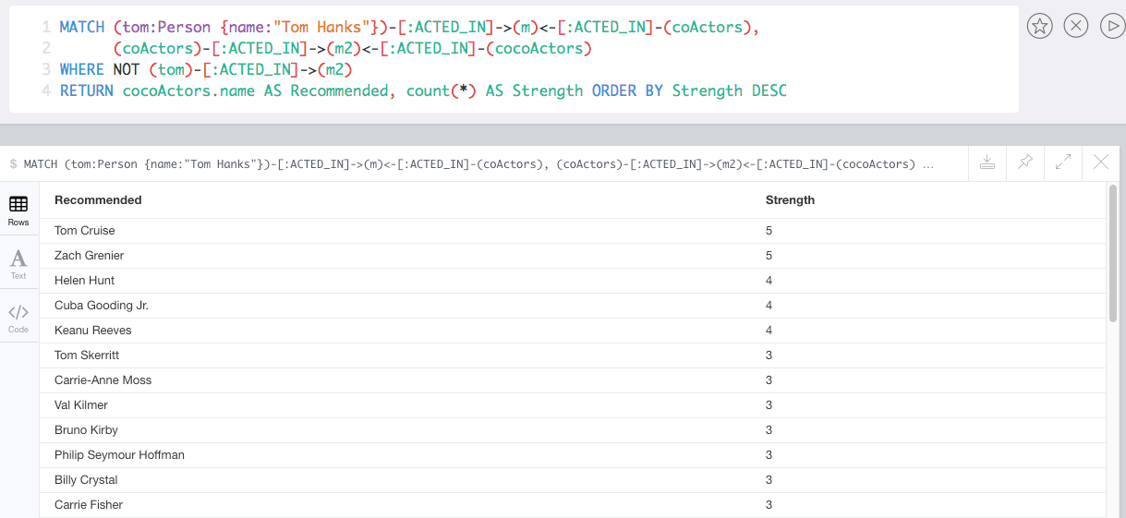
Recommend

Slide 89
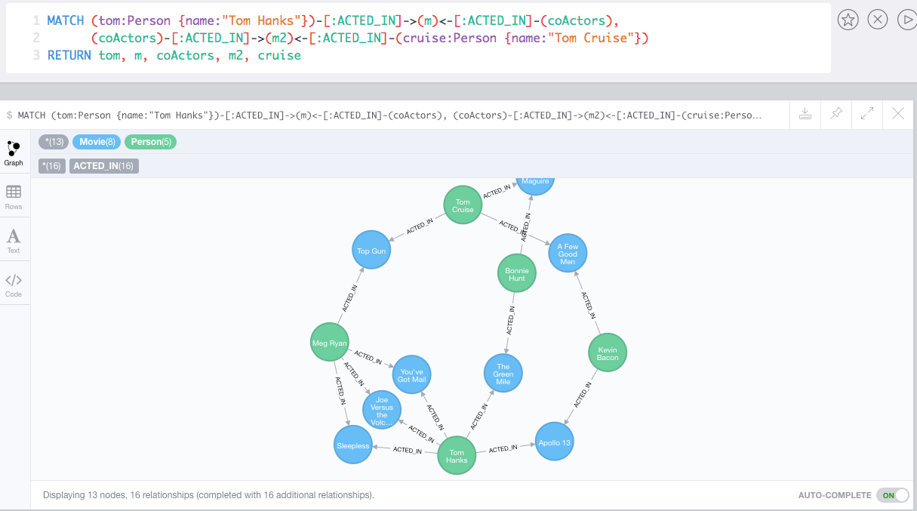
Which actors have worked with both Tom Hanks and
Tom Cruise?

Slide 90
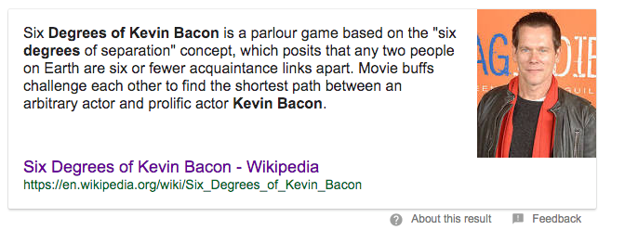
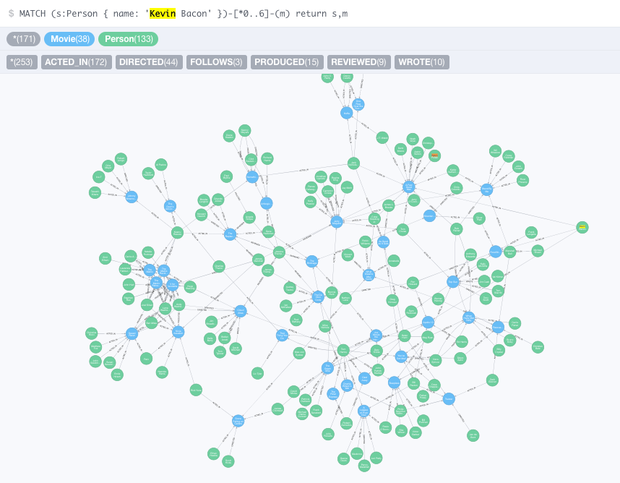


Slide 91
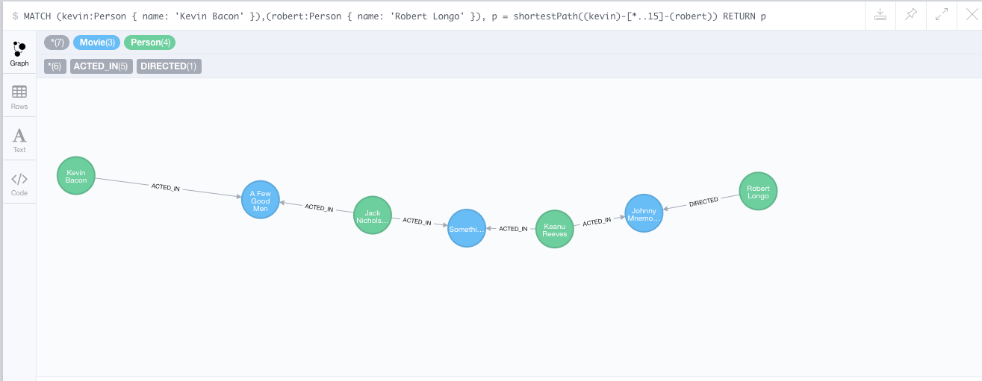
How do you get from Kevin Bacon to
Robert Longo?

Slide 92
Backup
92 | COMS W4111_002_2024_1 - Lecture 11: Module II (4), Normalization, NoSQL (4) © Donald F. Ferguson, 2024

Slide 93
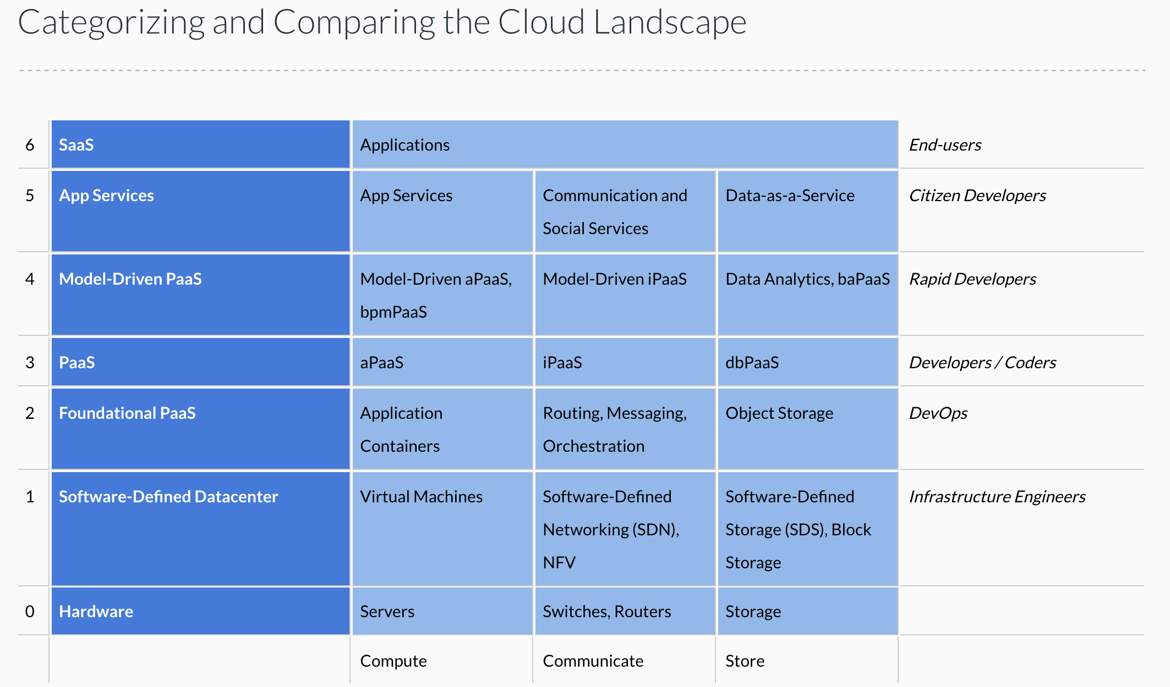
Cloud Concepts – One Perspective
http://www.theenterprisearchitect.eu/blog/2013/10/12/the-cloud-landscape-described-categorized-and-compared/

Slide 94
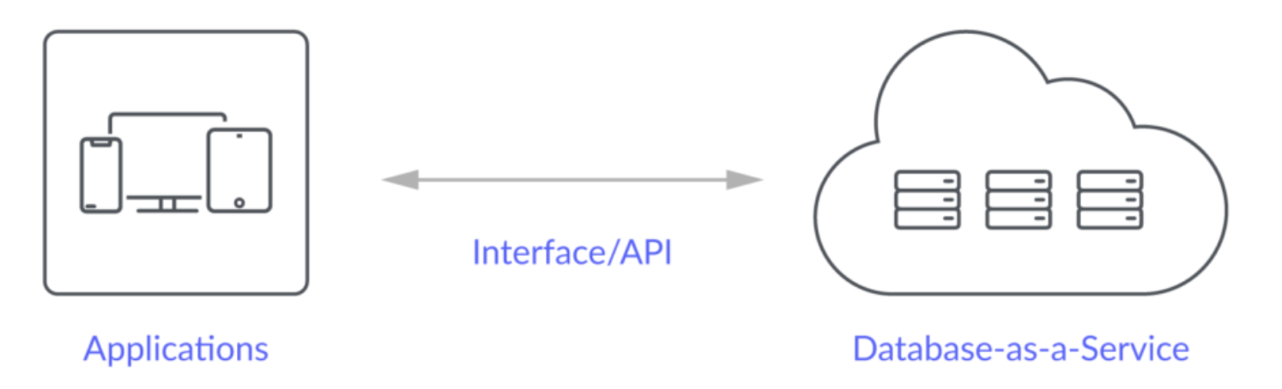
Database-as-a-Service
“A cloud database is a database that typically runs on a cloud computing platform and access to the database is provided as-a-service. There are two common deployment models: users can run databases on the cloud independently, using a virtual machine image, or they can purchase access to a database service, maintained by a cloud database provider. Of the databases available on the cloud, some are SQL-based and some use a NoSQL data model.
Database services take care of scalability and high availability of the database. Database services make the underlying software-stack transparent to the user.” (Wikipedia)

Slide 96
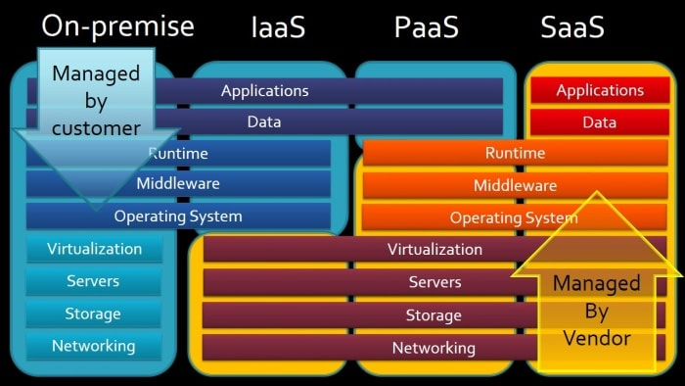
Cloud Computing Layers

